Slide 1
Introduction to Linux Shell and Shell Scripting

Slide 2
If you are using any major operating system you are indirectly interacting to shell. If you are running Ubuntu, Linux Mint or any other Linux distribution, you are interacting to shell every time you use terminal. Forunderstanding shell scripting we have to get familiar with following terminologies:
Kernel
Shell
Terminal

Slide 3


Slide 4
What is Kernel
The kernel is a computer program that is the core of a computer’s operating system, with complete control over everything in the system. It manages following resources of the Linux system –
File management
Process management
I/O management
Memory management
Device management etc.

Slide 5
What is Shell
A shell is special user program which provide an interface to user to use operating system services. Shell accept human readable commands from user and convert them into something which kernel can understand. It is a command language interpreter that execute commands read from input devices such as keyboards or from files. The shell gets started when the user logs in or start the terminal.

Slide 6
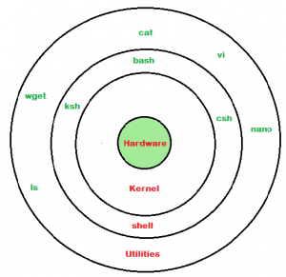

Slide 7
Shell is broadly classified into two categories –
Command Line Shell
Graphical shell

Slide 8
Command Line Shell
Shell can be accessed by user using a command line interface. A special program called Terminal in linux/macOS or Command Prompt in Windows OS is provided to type in the human readable commands such as “cat”, “ls” etc. and then it is being execute. The result is then displayed on the terminal to the user. A terminal in Ubuntu 16.4 system looks like this –

Slide 9
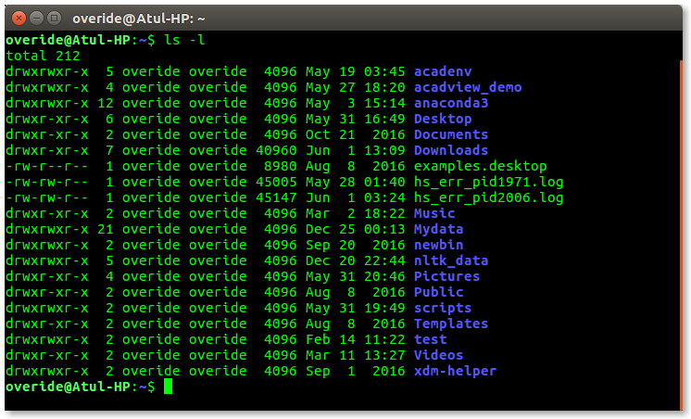

Slide 10
Graphical Shells
Graphical shells provide means for manipulating programs based on graphical user interface (GUI), by allowing for operations such as opening, closing, moving and resizing windows, as well as switching focus between windows. Window OS or Ubuntu OS can be considered as good example which provide GUI to user for interacting with program. User do not need to type in command for every actions.A typical GUI in Ubuntu system

Slide 11
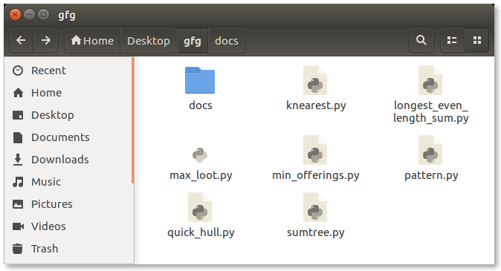

Slide 12
There are several shells are available for Linux systems like –
BASH (Bourne Again SHell) – It is most widely used shell in Linux systems. It is used as default login shell in Linux systems and in macOS. It can also be installed on Windows OS.
CSH (C SHell) – The C shell’s syntax and usage are very similar to the C programming language.
KSH (Korn SHell) – The Korn Shell also was the base for the POSIX Shell standard specifications etc.
Each shell does the same job but understand different commands and provide different built in functions.

Slide 13
Shell Scripting
Usually shells are interactive that mean, they accept command as input from users and execute them. However some time we want to execute a bunch of commands routinely, so we have type in all commands each time in terminal. As shell can also take commands as input from file we can write these commands in a file and can execute them in shell to avoid this repetitive work. These files are called Shell Scripts or Shell Programs. Shell scripts are similar to the batch file in MS-DOS. Each shell script is saved with .sh file extension eg. myscript.sh

Slide 14
A shell script have syntax just like any other programming language. If you have any prior experience with any programming language like Python, C/C++ etc. it would be very easy to get started with it.
A shell script comprises following elements –
Shell Keywords – if, else, break etc.
Shell commands – cd, ls, echo, pwd, touch etc.
Functions
Control flow – if..then..else, case and shell loops etc.

Slide 15
Why do we need shell scripts
There are many reasons to write shell scripts:
To avoid repetitive work and automation
System admins use shell scripting for routine backups
System monitoring
Adding new functionality to the shell etc.

Slide 16
Advantages of shell scripts
The command and syntax are exactly the same as those directly entered in command line, so programmer do not need to switch to entirely different syntax
Writing shell scripts are much quicker
Quick start
Interactive debugging etc.

